Slide 1
Data Structures and algorithms

Slide 2
Where, x and y are variables

Slide 3
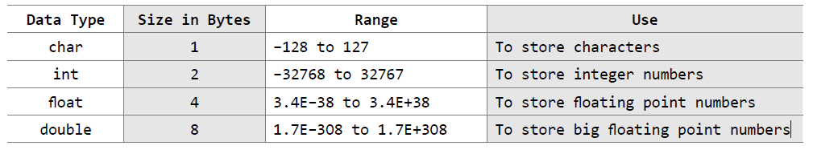
Data type determines the set of values that a data item can take and the operations that can be performed on the item
Basic data types in C

Slide 4
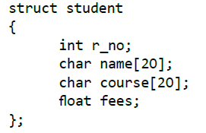
Data types:
System defined/ Primitive
Example: int, float, char, double, bool, etc.
User defined/ Non-primitive
Example: structures

Slide 5
What is data structure?

Slide 6
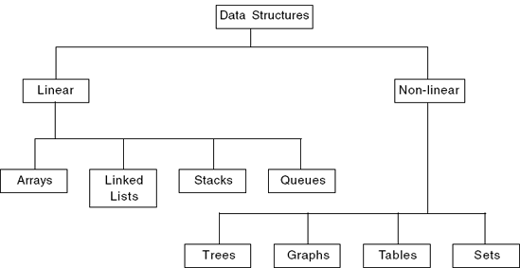
Data structure is a particular way of storing and organizing data in a computer so that it can be used efficiently

Slide 7
Linear data structures: Elements are accessed in a sequential order. Examples: Linked Lists, Stacks and Queues
Non – linear data structures: Elements of this data structure are stored/accessed in a non-linear order. Examples: Trees and graphs

Slide 8
Operations on Data structures
Traversing: Accessing each data item exactly once so that it can be processed. For example, to print the names of all the students in a class
Searching : Finding the location of one or more data items that satisfy the given constraint. Such a data item may or may not be present in the given collection of data items. For example, to find the names of all the students who secured 100 marks in mathematics
Inserting : Adding new data items to the given list of data items. For example, to add the details of a new student who has recently joined the course
Deleting: Removing a particular data item from the given collection of data items. For example, to delete the name of a student who has left the course
Sorting: Arranging data items in some logical order like ascending order or descending order depending on the type of application. For example, arranging the names of students in a class in an alphabetical order, or calculating the top three winners by arranging the participants’ scores in descending order and then extracting the top three
Merging Lists of two sorted data items can be combined to form a single list of sorted data items

Slide 9
Abstract Data Types (ADTs)
An ADT refers to a set of data values and associated operations that are specified accurately, independent of any particular implementation
Declaration of data
Declaration of operation

Slide 10
What is an algorithm?

Slide 11
Algorithm: An algorithm is the step-by-step unambiguous instructions to solve a given problem
Criteria for judging an algorithm
correctness (does the algorithm give solution to the problem in a finite number of steps?)
efficiency (how much resources in terms of memory and time does it take to execute)

Slide 12
Goal of the Analysis of Algorithms
The goal of the analysis of algorithms is to compare algorithms (or solutions) mainly in terms of running time as well as other factors (e.g., memory, developer effort, etc.)
How to Compare Algorithms
Time complexity
Space complexity

Slide 13
The time complexity of an algorithm is basically the running time of a program as a function of the input size
The space complexity of an algorithm is the amount of computer memory that is required during the program execution as a function of the input size

Slide 14
Types of Analysis
To analyze the given algorithm, we need to know with which inputs the algorithm takes less time and with which inputs the algorithm takes a long time
Worst case
Best case
Average case

Slide 15
Worst case
Defines the input for which the algorithm takes a long time (slowest time to complete).
Input is the one for which the algorithm runs the slowest.
Best case
Defines the input for which the algorithm takes the least time (fastest time to complete).
Input is the one for which the algorithm runs the fastest.
Average case
Provides a prediction about the running time of the algorithm.
Run the algorithm many times, using many different inputs that come from some distribution that generates these inputs, compute the total running time (by adding the individual times), and divide by the number of trials.
Assumes that the input is random.

Slide 16
Big-O Notation [Upper Bounding Function]
This notation gives the tight upper bound of the given function. Generally, it is represented as
f(n)= O(g(n))
That means, at larger values of n, the upper bound of f(n) is g(n).

Slide 17
For example, if
f(n)=
is the given algorithm, then is g(n). That means g(n) gives the maximum rate of growth for f(n) at larger values of n.

Slide 18
O–notation is defined as
O(g(n)) = {f(n): there exist positive constants c and such that 0 ≤ f(n) ≤ cg(n) for all n ≥ }
g(n) is an asymptotic tight upper bound for f(n).

Slide 19
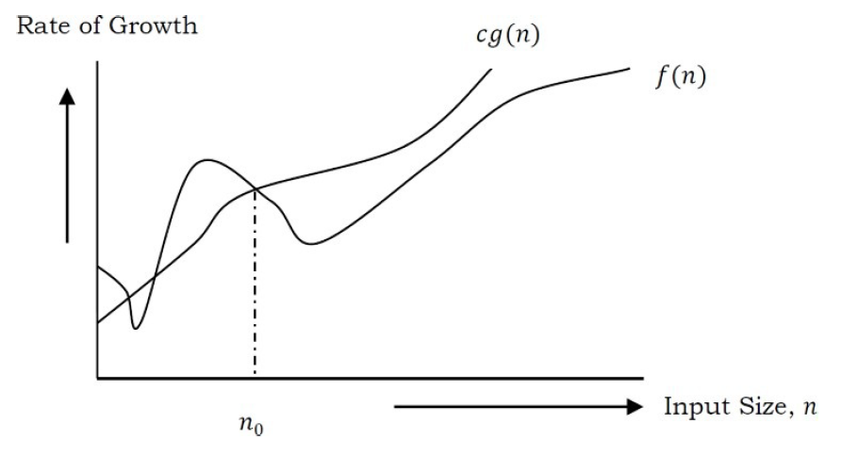

Slide 20
Exercise-1 Find upper bound for f(n) = 3n + 8
Exercise-2 Find upper bound for f(n) =
Exercise-3 Find the upper bound for
f(n) =
Exercise-4 Find the upper bound for f(n) =

Slide 21
Omega-Ω Notation [Lower Bounding Function]
This notation gives the tight lower bound of the given algorithm and it is represented as
f(n) = Ω(g(n))
That means, at larger values of n, the tighter lower bound of f(n) is g(n).

Slide 22
Ω notation can be defined as
Ω(g(n)) = {f(n): there exist positive constants c and such that 0 ≤ cg(n) ≤ f(n) for all n ≥ }
g(n) is an asymptotic tight lower bound for f(n)

Slide 23
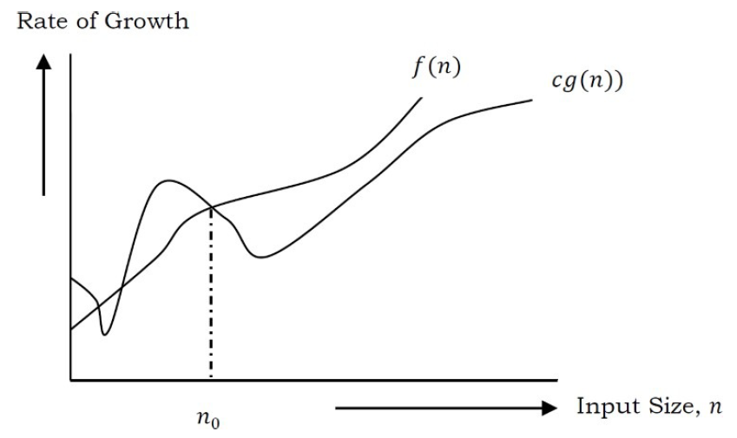

Slide 24
Exercise-1 Find lower bound for f(n) = 3n + 8
Exercise-2 Find lower bound for f(n) =
Exercise-3 Find the lower bound for
f(n) =
Exercise-4 Find the lower bound for
f(n) =

Slide 25
Theta-Θ Notation [Order Function]
This notation decides whether the upper and lower bounds of a given function (algorithm) are the same.
The average running time of an algorithm is always between the lower bound and the upper bound. If the upper bound (O) and lower bound (Ω) give the same result, then the Θ notation will also have the same rate of growth.

Slide 26
Θ Notation can be defined as
Θ(g(n)) = {f(n): there exist positive constants
0 ≤ g(n) ≤ f(n) ≤ g(n) for all n ≥ }
g(n) is an asymptotic tight bound for f(n)

Slide 27
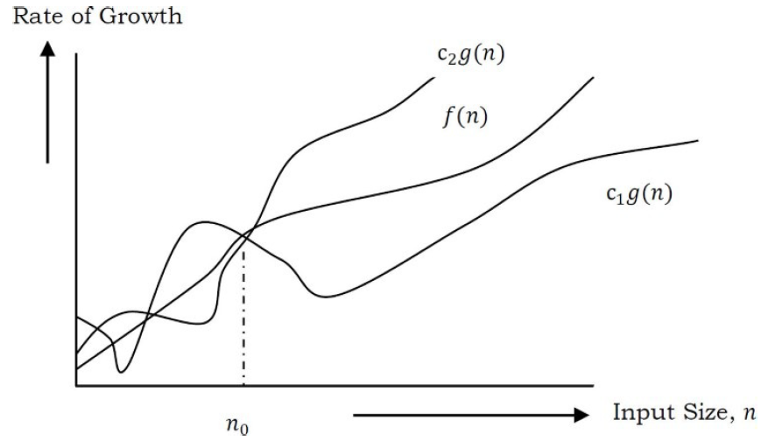

Slide 28
Arrays

Slide 29
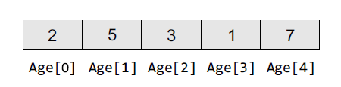
Arrays
Collection of same type of variables that under a common name

Slide 30
Calculating the Address of Array Elements
Address of data element,
A[k] = BA(A) + w(k – lower_bound)
Here, A is the array, k is the index of the element of which we have to calculate the address, BA is the base address of the array A, and w is the size of one element in memory

Slide 31
Example:
Given an array int marks[] = {99,67,78,56,88,90,34,85}, calculate the address of marks[4] if the base address = 1000.

Slide 32
Operations on Arrays
Traversing an array
Inserting an element in an array
Searching an element in an array
Deleting an element from an array
Merging two arrays
Sorting an array in ascending or descending order

Slide 33
Traversing an Array
Step 1: [INITIALIZATION] SET I = lower_bound
Step 2: Repeat Steps 3 to 4 while I <= upper_bound
Step 3: Apply Process to A[I]
Step 4: SET I = I + 1
[END OF LOOP]
Step 5: EXIT

Slide 34
Inserting an element in an array
INSERT (A, N, POS, VAL)
Step 1: [INITIALIZATION] SET I = N
Step 2: Repeat Steps 3 and 4 while I >= POS
Step 3: SET A[I + 1] = A[I]
Step 4: SET I = I – 1
[END OF LOOP]
Step 5: SET N = N + 1
Step 6: SET A[POS] = VAL
Step 7: EXIT

Slide 35
Deleting an element from an array
DELETE(A, N, POS)
Step 1: [INITIALIZATION] SET I = POS
Step 2: Repeat Steps 3 and 4 while I <= N – 1
Step 3: SET A[I] = A[I + 1]
Step 4: SET I = I + 1
[END OF LOOP]
Step 5: SET N = N – 1
Step 6: EXIT

Slide 36
Exercise:
main()
{
int *p;
int sample[10];
p = sample;
printf(“%d”, p);
}

Slide 37
Exercise:
main()
{
int arr[] = {2, 3, 4, 5, 6};
printf(“%d”, sizeof(arr));
}

Slide 38
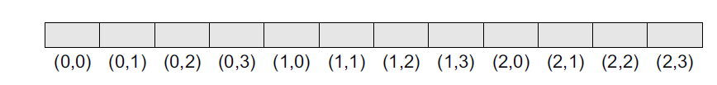
Two-Dimensional Arrays
Row major order
Address(A[I][J]) = Base_Address + w{col ( I – LR) + (J – LC)}

Slide 39
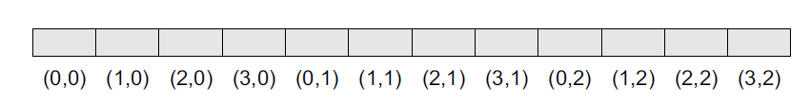
Column major order
Address(A[I][J]) = Base_Address + w{row ( J – LC) + (I – LR)}

Slide 40
Operations on two-Dimensional Arrays
Transpose
Sum
Difference
Product

Slide 41
Advantages of Arrays
• Simple and easy to use
• Faster access to the elements (constant access)

Slide 42
Disadvantages of Arrays
• Pre-allocates all needed memory up front and wastes memory space for indices in the array that are empty.
• Fixed size: The size of the array is static (specify the array size before using it).
• One block allocation: To allocate the array itself at the beginning, sometimes it may not be possible to get the memory for the complete array (if the array size is big).
• Complex position-based insertion: To insert an element at a given position, we may need to shift the existing elements.

Slide 43
Representation of polynomial
struct poly
{
int coeff;
int exp;
};
struct poly a[50],b[50],c[50];

